Slide 1
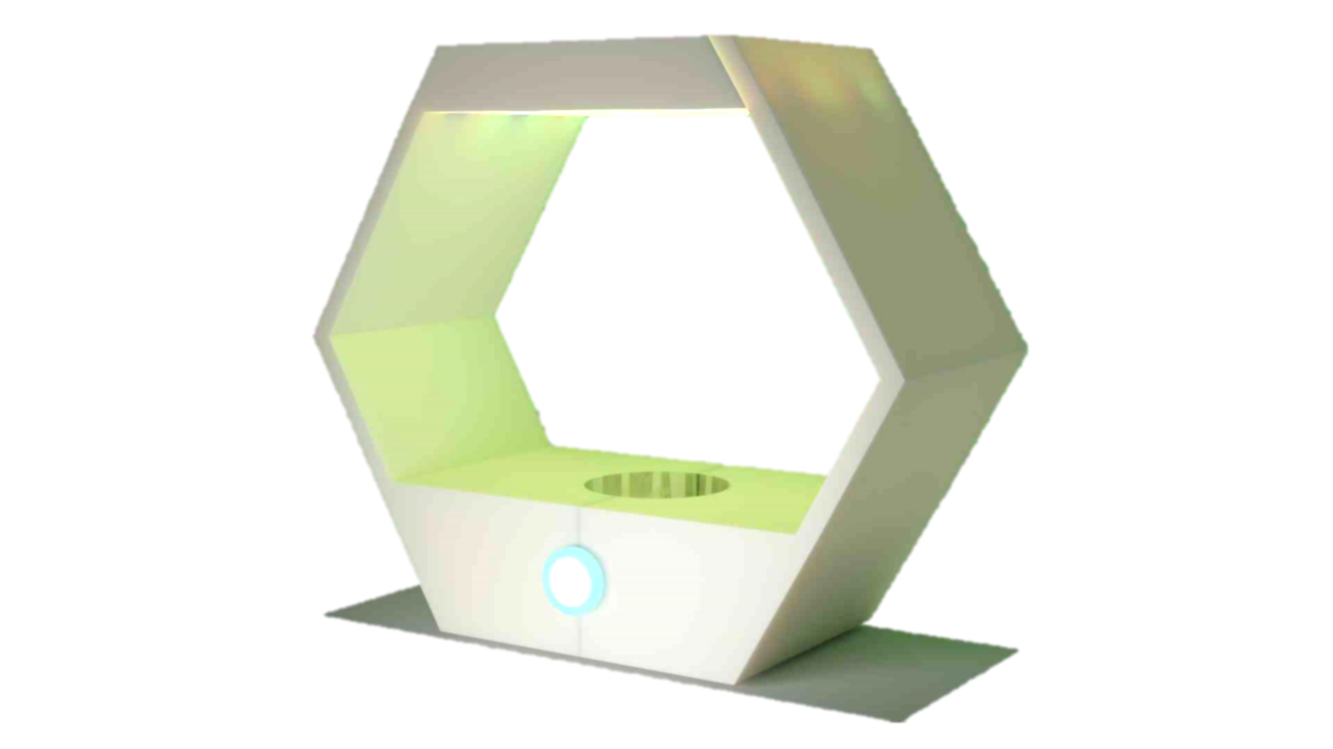
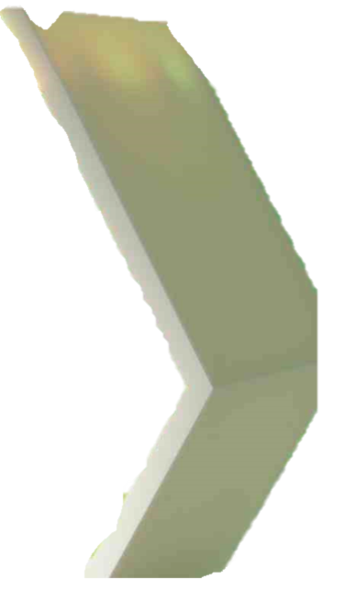
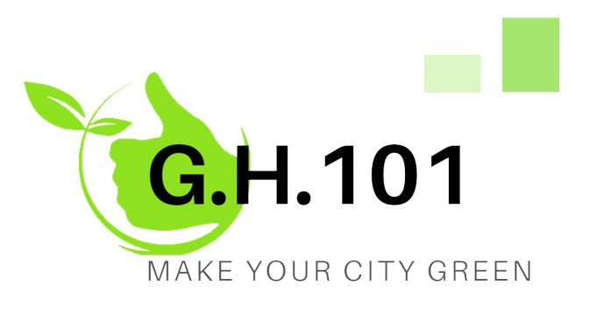

Slide 2
Team members
Berti Marco s315819
Brozzo Doda Umberto s314562
Dettori Giovanni s315017
Macario Davide s315054

Slide 3


The idea - overview
Our goal is to help people take care of their plants without worrying about watering them or how much light they need through an user friendly platform and remote monitoring
Retrieving and collecting data from remote sensors
Analysis of environment parameters for weather prediction
Remote access to greenhouse consumption and needs
Analysis of parameters for optimal plant growth

Slide 4
Communication protocols used
REST Web Service
MQTT
It provides synchronous communications among the microservices using CRUD methods .
It exposes addressable resources through URI
It provides asynchronous communications among publishers and subscribers using a message broker.
message exchange is based on topics

Slide 5
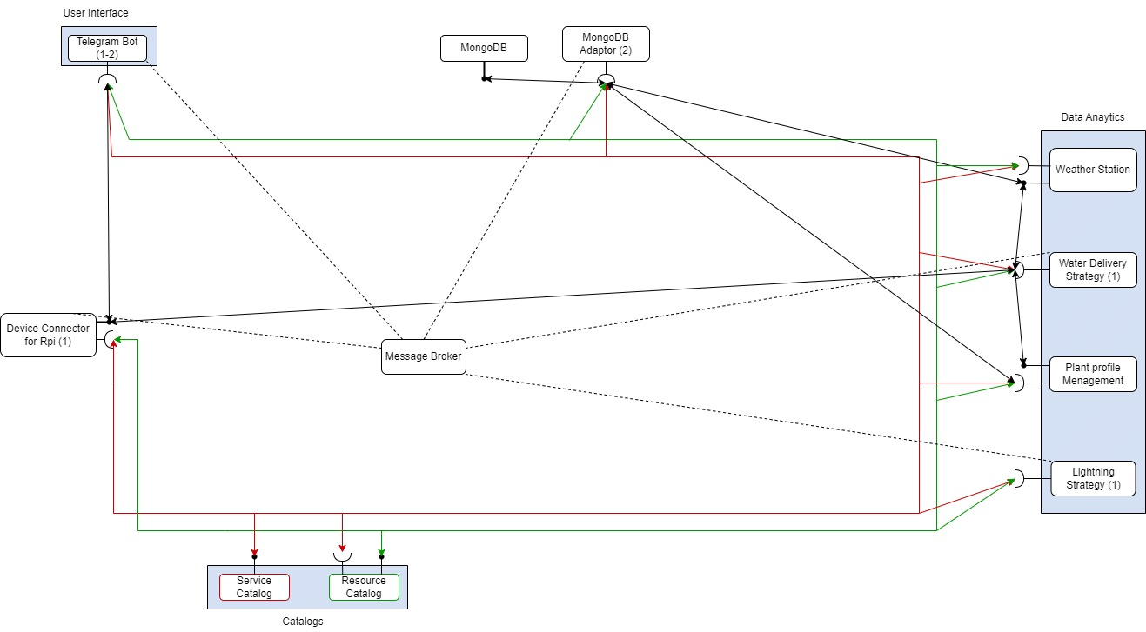

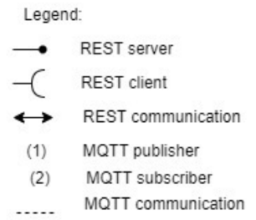
Use Case Diagram - Proposal

Slide 6
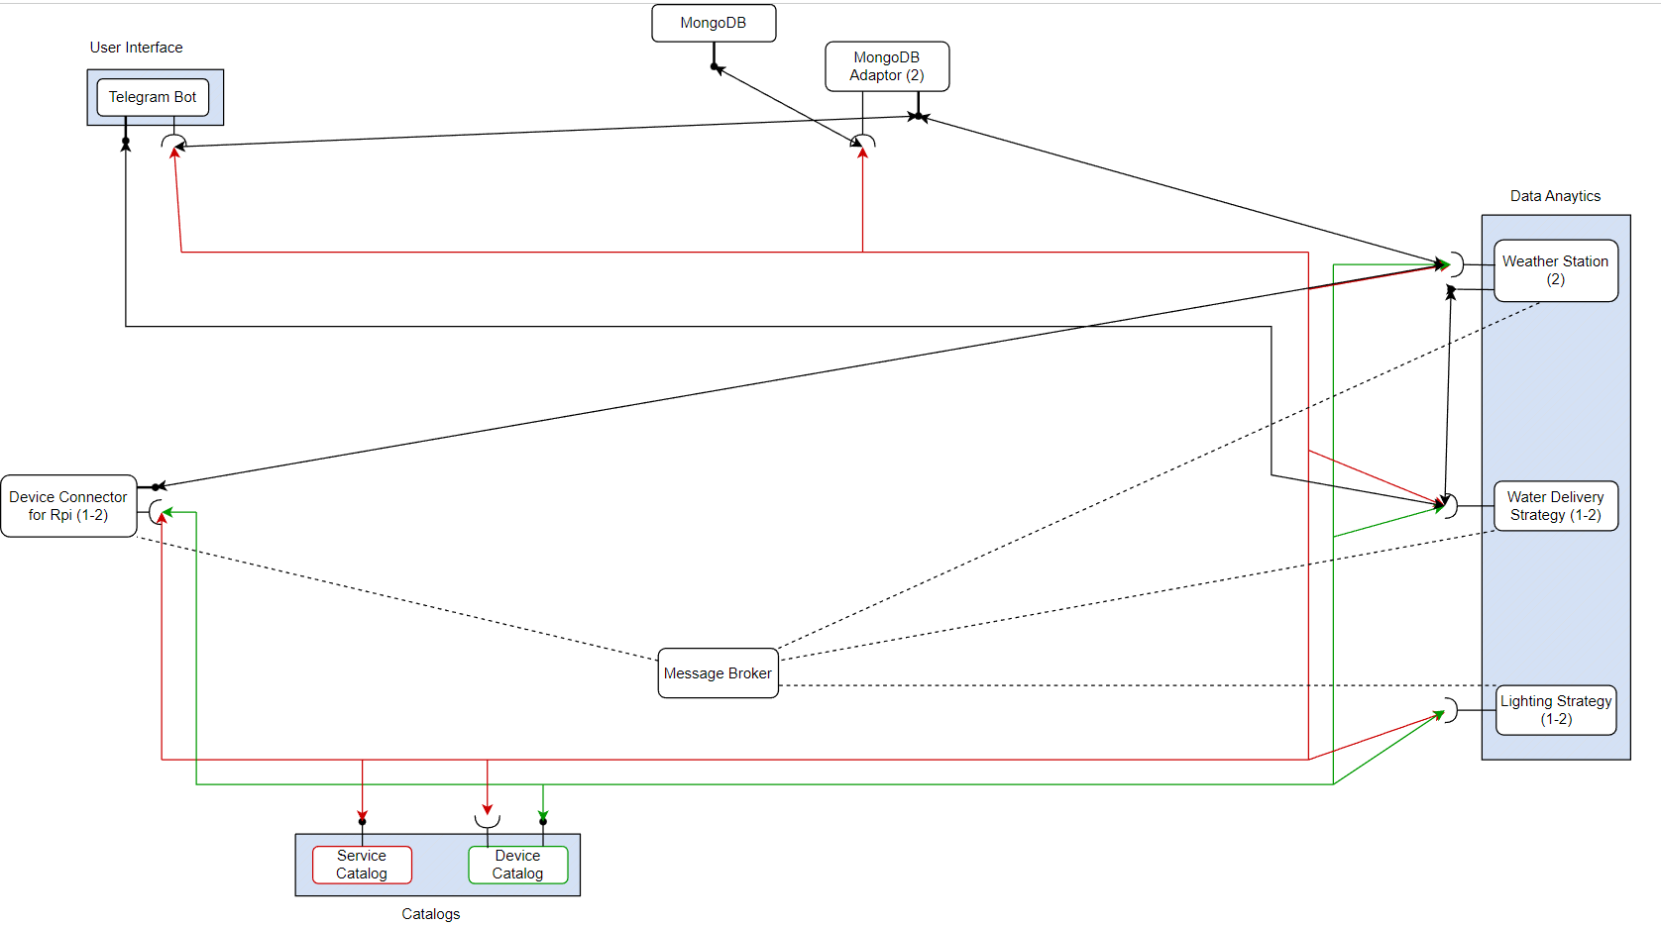
Use Case Diagram - Modified

Slide 7
Microservices
Step by step

Slide 8
Service catalog
Project owner
Project name
Service catalog
Broker
Device catalog
Telegram bot
Green-houses
Users
Services
It is the service registry for the application. It allows different application entities to obtain a list of all available services and how to interface with them (i.e., the needed APIs) and it provides the means for service advertisement.
Stored information

Slide 9
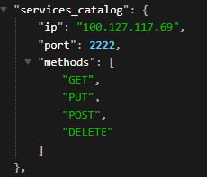
Service catalog
Messages exchange with this element happens over REST Web Services with JSON files and each application element must retrieve information upon start up. The Service catalog must be known by every microservice in advance.

Slide 10
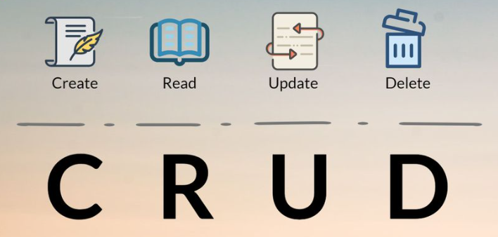
Service Catalog
GET
POST
PUT
It retrieves the information.
Project info
Broker
Telegram bot
Device catalog
Users / user (given ID)
Greenhouses / greenhouse (given ID)
Services / service (given ID)
It inserts the information.
Device catalog
User
Greenhouse
Service
It updates information.
Device catalog
User
Greenhouse
Service

Slide 11
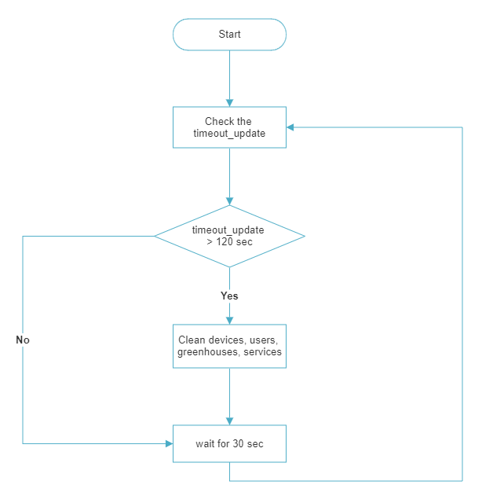
Service catalog Main loop
The catalog keeps updated the list of users, greenhouses, services and devices. It controls which are still connected and removes those who are not available anymore.

Slide 12
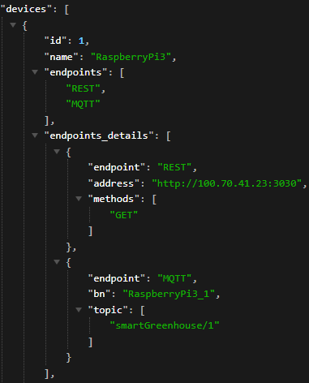
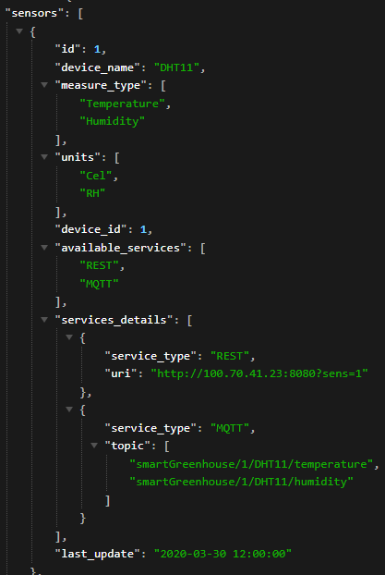
Device Catalog
It is the device registry for the application, providing a list of all available devices and the resources they expose.
Each device exposes all sensors that a micro-service can use.

Slide 13

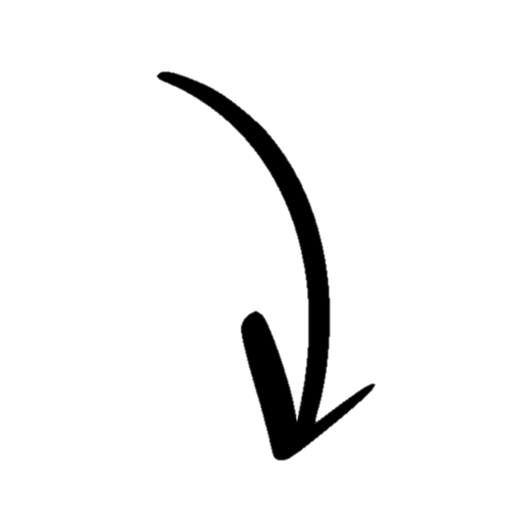
Device Catalog
GET
It retrieves the information.
Devices / device (given ID)
Devices / device (given name)
POST
It inserts the information.
Device
PUT
It updates information.
Device

Slide 14
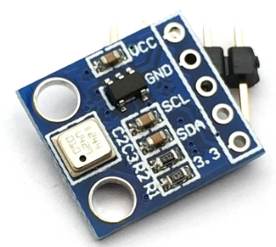
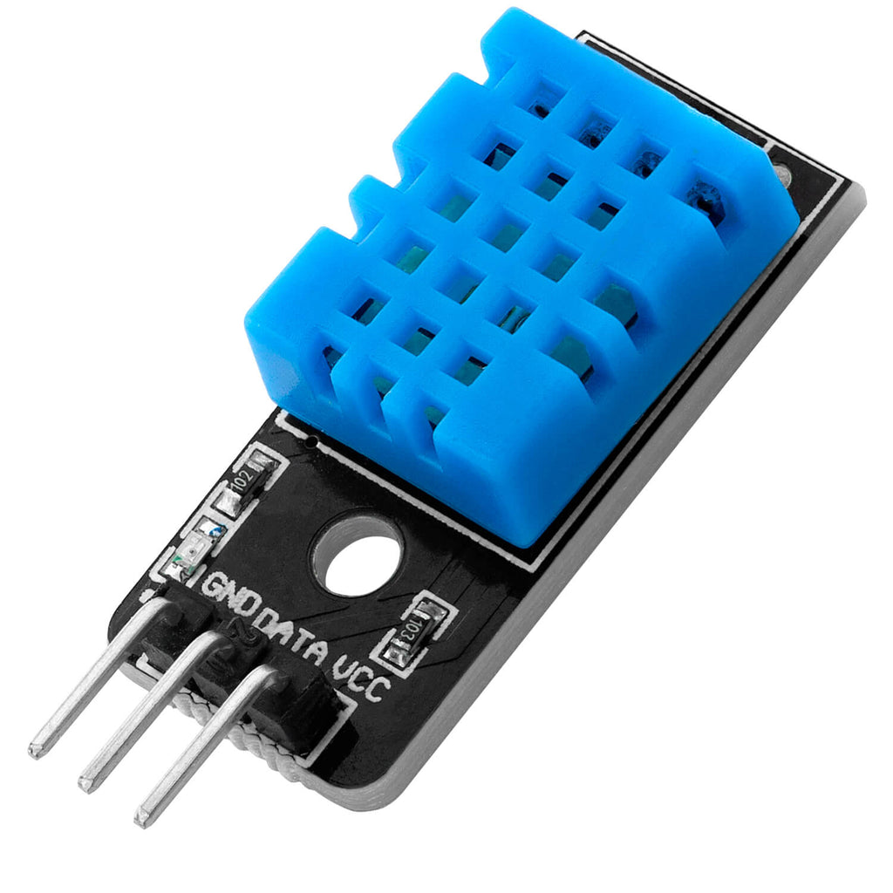
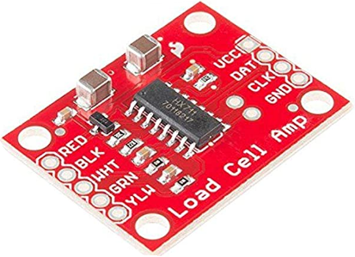
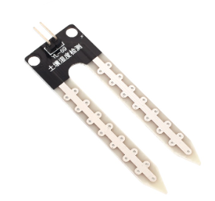
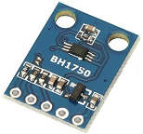

Raspberry Pi connector
It is the Device Connector referring to a specific greenhouse. Each one is equipped with 5 sensors:
BMP180
Used to measure the temperature and pressure
DHT11
Used to measure the temperature and humidity
HX711
Used to measure the tank weight
YL-69 (chirp)
Used to measure the soil moisture
BH1750
Used to measure the light intensity

Slide 15
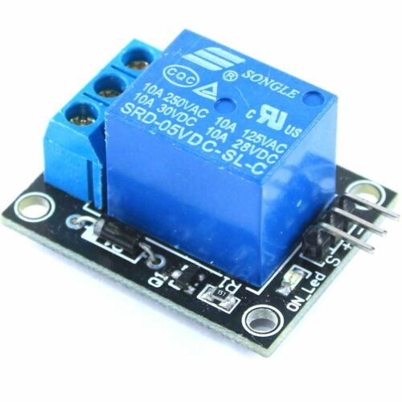
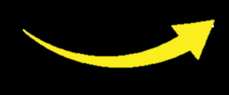
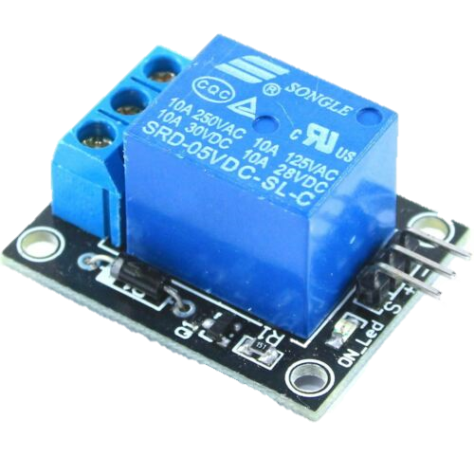

Raspberry Pi connector
It is the Device Connector referring to a specific greenhouse. Each one is equipped with 5 sensors.
And 2 actuators:
One to control the light system
Two KEYES_SRLY
The other to control the irrigation system

Slide 16

Raspberry Pi connector
The Raspberry Pi receives as input the information related to the plant the user wants to grow.
Information is exchanged both over:
REST APIs, for instantaneous readings requested by the user though the GET.
MQTT: every 10 minutes it receives the measures from sensors and forwards them to the proper strategy.
Lightening strategy
Water delivery strategy
Weather station strategy

Slide 17
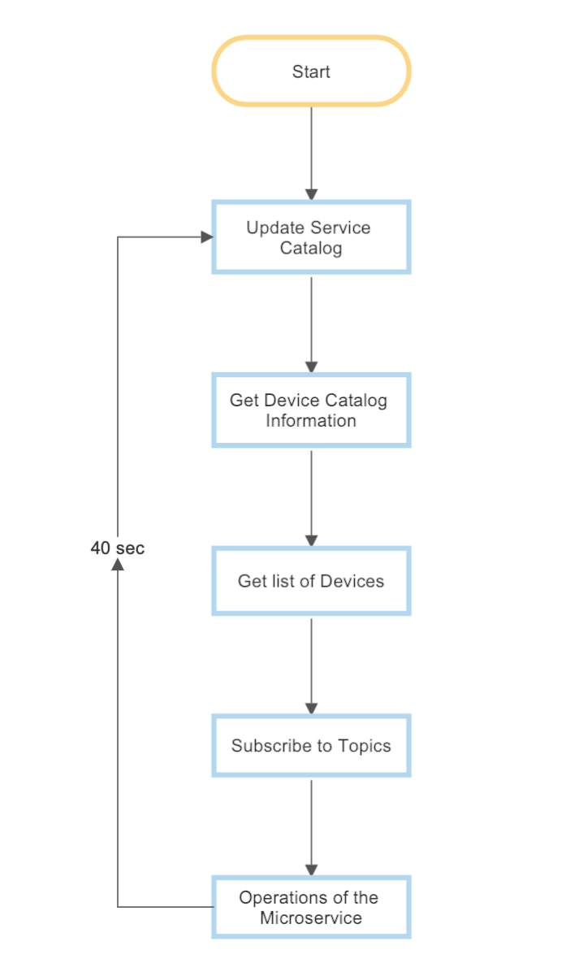
Main loop of the strategies
In the initialization (start), strategies register to the service catalog.
Then, the main loop is started and every 40 seconds the strategy updates its information to the service catalog to prevent the timeout from expiring.

Slide 18
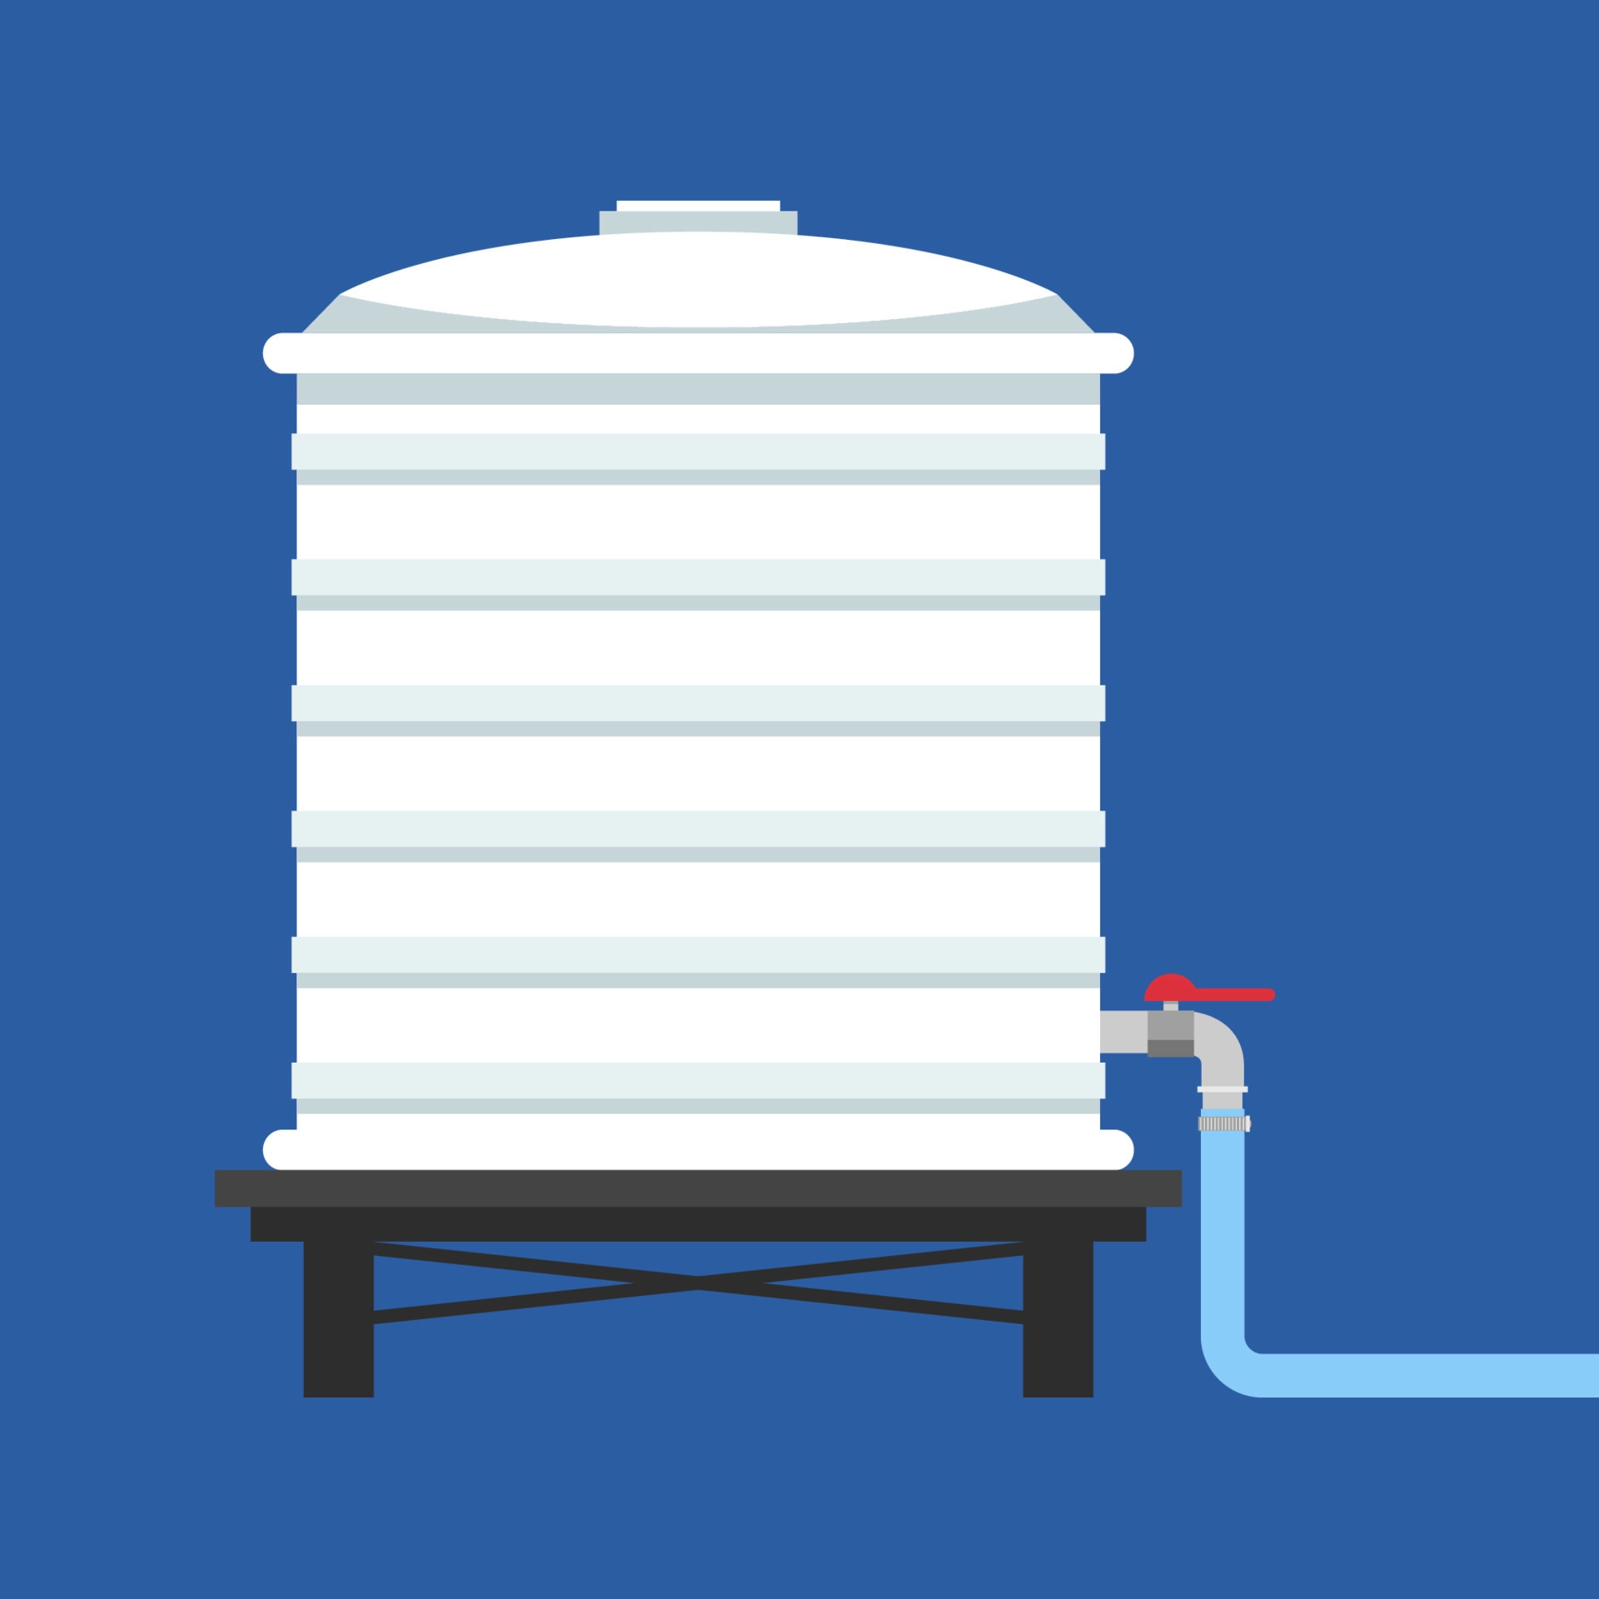
Water delivery strategy
It is a microservice for the application which is able to read data from sensors (water tank level and soil moisture) and decides if it is necessary to water the plant.
Water tank level: based on quantity of water in the tank and on the weather (it will rain or not tomorrow) it can send a message to the user to manually fill the tank or to let the rain fill it
Soil moisture: by comparing the sensor value with the water needs of the plant, it can decide to water the plant or not through an actuator.

Slide 19
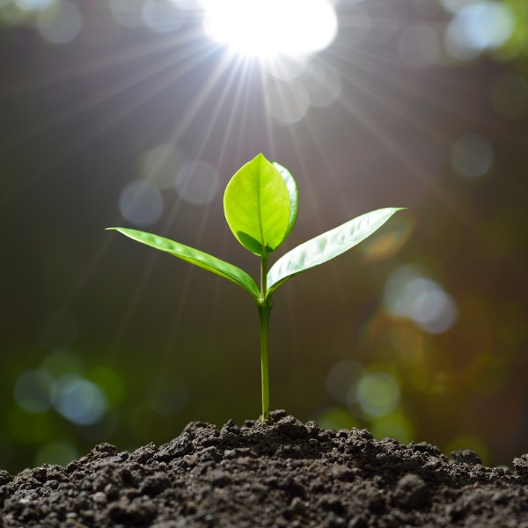
Lighting strategy
It is a micro service for the application which is able to read data from a sensor (light intensity) and decides if it necessary to switch on/off the light
Light intensity: by comparing the sensor value with the light needs of the plant during the day, it can decide to light the plant.

Slide 20
Weather station
It is a microservice for the application which is able to read data from the sensors (temperature, pressure and air-humidity) and provide to the user (via Telegram) the current weather.
Information is exchanged both over:
GET:
Current weather: used to inform the user via Telegram about the current weather.
Will it rain: used by the water delivery strategy to know if the day after will rain.
MQTT: used to receive sensors values and fit them to perform the machine learning algorithm

Slide 21
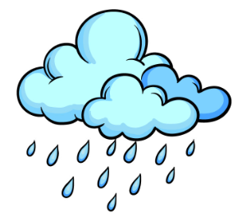
Weather station
Additionally, it calls the weather prediction to retrieve weather (rain) forecasting respect the present and the next day.
Using past data retrieved from Meteo.it we trained the Quadratic discriminant model to have the prediction. At the and we obtain an accuracy of 83% for the present day and 77% for the next day. These two output are good considering that the common accuracy of weather foreign is around 89%.
For each day we have used:
Where ‘FENOMENI’ gives the output (rain presence or not) and ‘STAGIONE’ has been used to improve the performance.
['TMEDIA','TMIN','TMAX','UMIDITA','PRESSIONESLM','STAGIONE','FENOMENI']

Slide 22
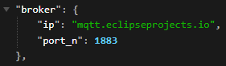
Message broker
It is a server which enables asynchronous communication by storing messages exchanged via MQTT under different topics. It is the key element in asynchronous communication.

Slide 23

It is a non relational database that exchanges JSON documents.
It is a service used for managing data, exchanged over REST Web Services. It is used to store measured data coming from the weather prediction strategy and a big collections of 2759 plants.
The plant’s database has been retrieved from a bigger online database. Thanks to data cleaning operations we have corrected and rearranged the records.

Slide 24

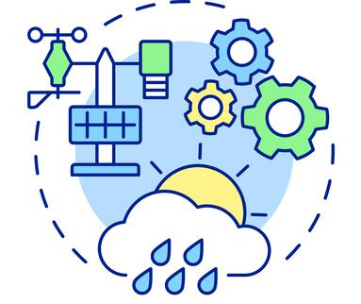
MongoDB adaptor
It makes possible the communication between the database and the other microservices.
In particular, it talks through REST with:
TELEGRAM BOT: to retrieve the information of a plant and chose the best ones based on user preferences (e.g.: size, country, temperature,…).
WEATHER STATION: to memorize the statistics of all days providing an historical trace of the behaviour of the greenhouse. In this way the user can control the wealth of the plant.

Slide 25
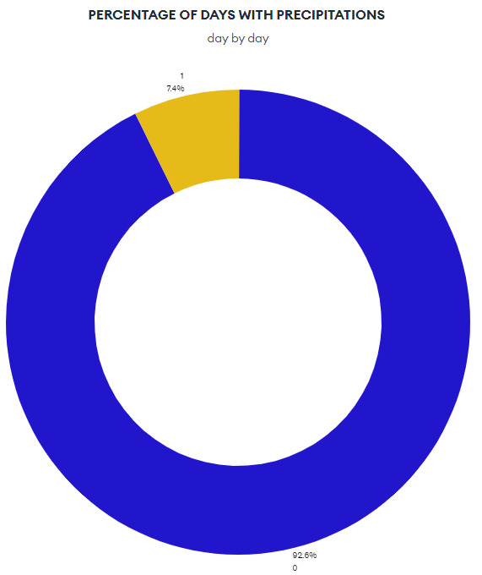
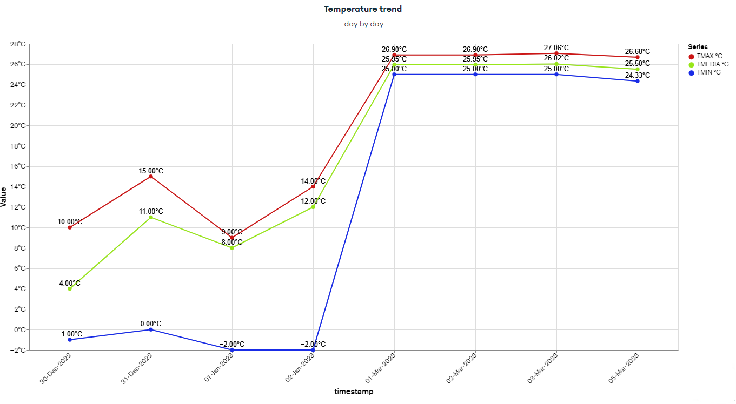
MongoDB charts
This powerful platform lets to visualize data in a intuitive way.
In our application we have given the possibility to the user to retrieve four graphs through the URL of a dynamic image.
We provide the temperature, the percentage of days with precipitations, humidity and pressure.

Slide 26
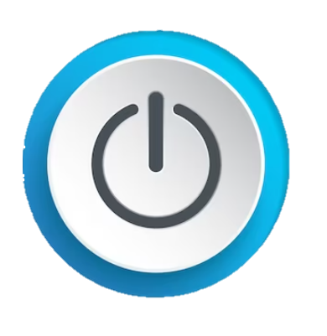
Telegram Bot
The user interface is provided by the telegram bot. The user just need to press the “START” button to access the application and receive the list of command he/she can perform.

Slide 27
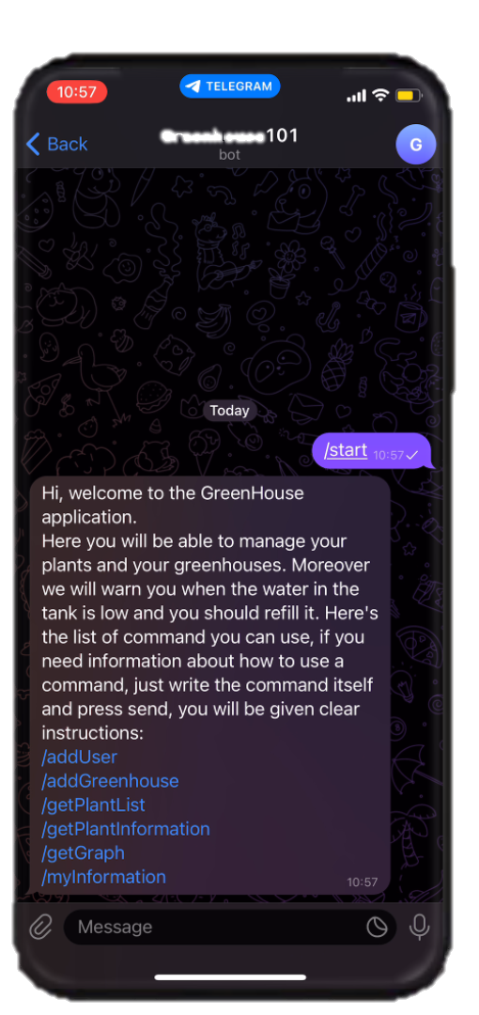
Telegram Bot
At this point the user chose one of the following commands on chat:
/addUser: to add a new user
/addGreenhouse: to add a new greenhouse
/getPlantList: to get a list of plants matching a need of the plant
/getPlantInformation: to get the information of a plant
/getGraph: to get graphs about weather and temperature
/myInformation —> to get user’s data

Slide 28
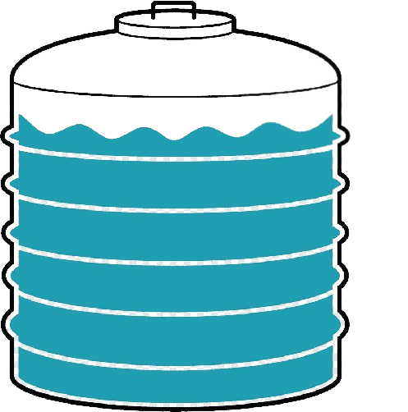
Telegram Bot
It implements a REST interface, in particular:
POST: provides an opportunity for the water delivery strategy to contact the user to alert him that the tank level is low.
In this way he can refill it.

Slide 29

Thanks for your attention
Gruppo 17

